Slide 1
06 | Clustering
Cynthia Rudin | MIT Sloan School of Management

Slide 2
Clustering
K-Means clustering algorithm and examples
K-Means derivation
Hierarchical agglomerative clustering algorithm and examples
Comparison

Slide 3
Recap of unsupervised learning and intro to clustering
Cynthia Rudin | MIT Sloan School of Management

Slide 4
Unsupervised Learning
“Unsupervised” means that the training data has no ground truth labels to learn from.
Supervised:
(chair)
(not a chair)
(not a chair)
chair?
(chair)
(not a chair)
(chair)
(not a chair)

Slide 5
Unsupervised Learning
“Unsupervised” means that the training data has no ground truth labels to learn from.
Unsupervised:

Slide 6
Unsupervised Learning
“Unsupervised” means that the training data has no ground truth labels to learn from.
Unsupervised:

Slide 7
Unsupervised Learning
“Unsupervised” means that the training data has no ground truth labels to learn from.
This means they are much harder to evaluate.
Clustering is an key unsupervised problem.

Slide 8
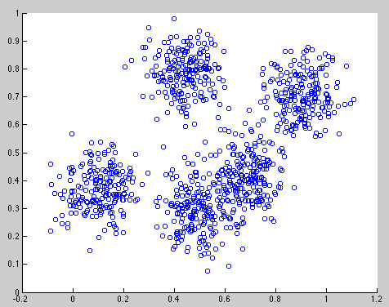
Clustering
Data within a cluster should be similar to other members of the cluster.
Notes:
jellyroll

Slide 9
Clustering
Data within a cluster should be similar to other members of the cluster.
Notes:
jellyroll

Slide 10
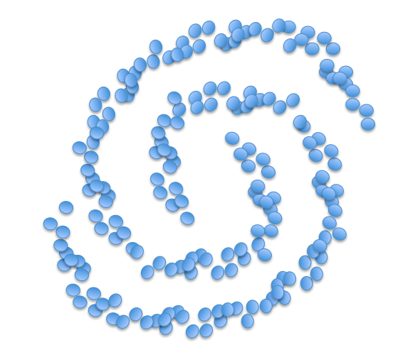
Clustering
Data within a cluster should be similar to other members of the cluster.
Notes:
jellyroll

Slide 11
Clustering
Applications include:
Automatically grouping documents/webpages into topics
For instance, grouping news stories from today into categories
Clustering large number of products
E.g., etsy products
Clustering customers into those with similar purchase behavior
Notes:
jellyroll

Slide 12
Clustering
Tricky to evaluate the quality of a clustering. No ground truth.
Notes:
--
One way to test algorithms is to generate the data according to a simulation, so we know ground truth. We can determine whether the clustering algorithm can recover the underlying clusters

Slide 13
K-Means Clustering

Slide 14
Clustering
K-means clustering
Input number of clusters, randomly initialize centers
Assign all points to the closest cluster center
Change cluster centers to be in the middle of its points
Repeat until convergence

Slide 15
K-Means in action
Input number of clusters, randomly initialize centers
Assign all points to the closest cluster center
Change cluster centers to be in the middle of its points
Repeat until convergence

Slide 16
K-Means in action
Input number of clusters, randomly initialize centers
Assign all points to the closest cluster center
Change cluster centers to be in the middle of its points
Repeat until convergence

Slide 17
K-Means in action
Input number of clusters, randomly initialize centers
Assign all points to the closest cluster center
Change cluster centers to be in the middle of its points
Repeat until convergence
Notes:
This induces what’s called a voronoi partition of the space.

Slide 18
K-Means in action
Input number of clusters, randomly initialize centers
Assign all points to the closest cluster center
Change cluster centers to be in the middle of its points
Repeat until convergence

Slide 19
K-Means in action
Input number of clusters, randomly initialize centers
Assign all points to the closest cluster center
Change cluster centers to be in the middle of its points
Repeat until convergence

Slide 20
Ready to see it?

Slide 21
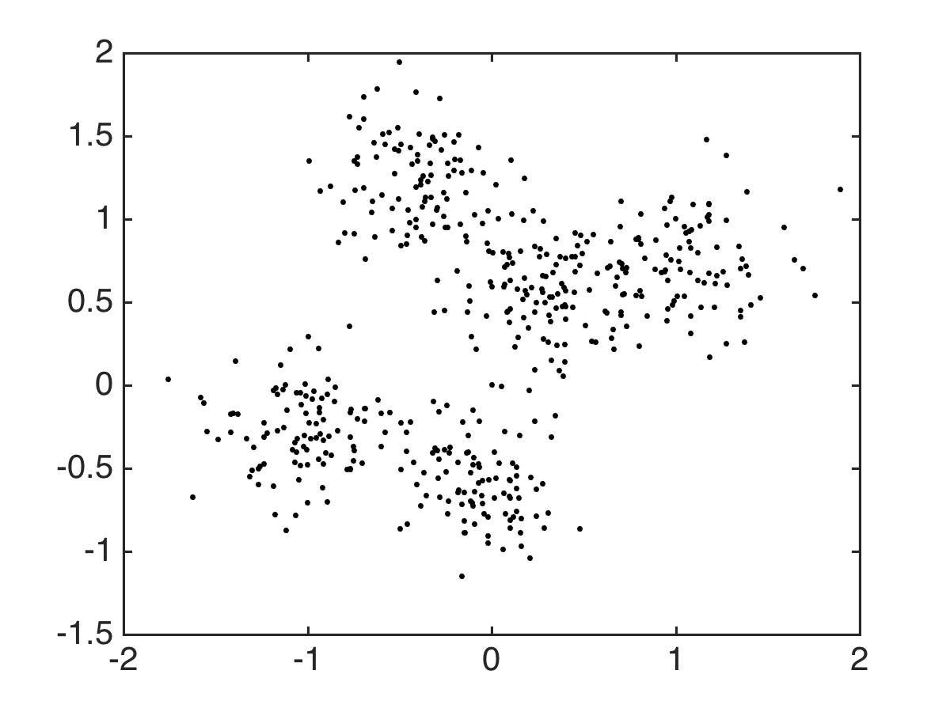

Slide 22
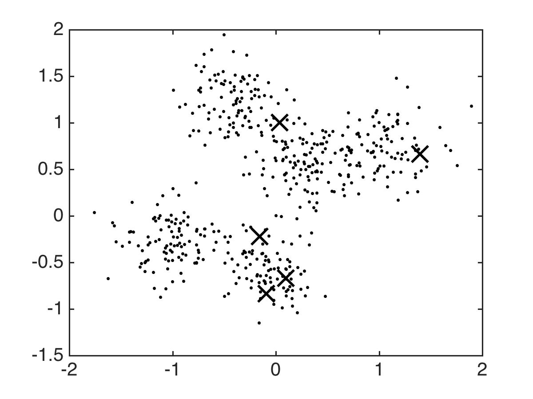
Notes:
So all these guys on the left, who are they going to get assigned to? Where will that center go?

Slide 23
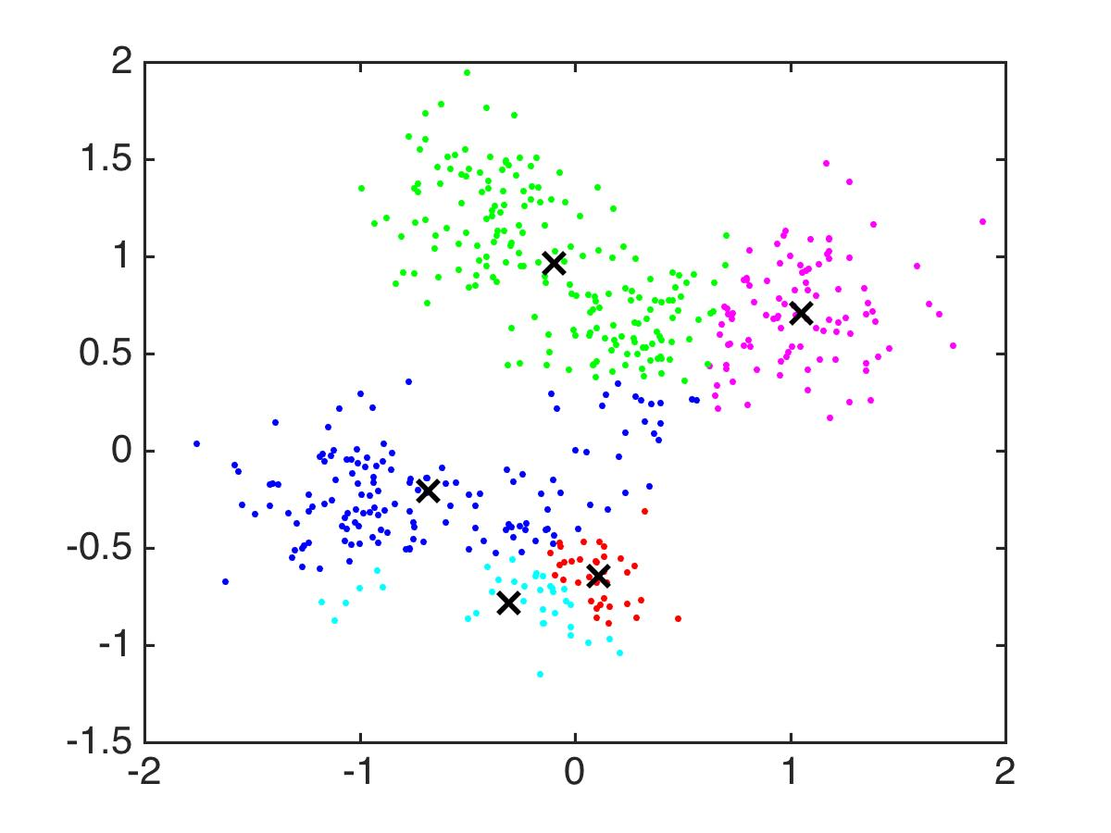

Slide 24
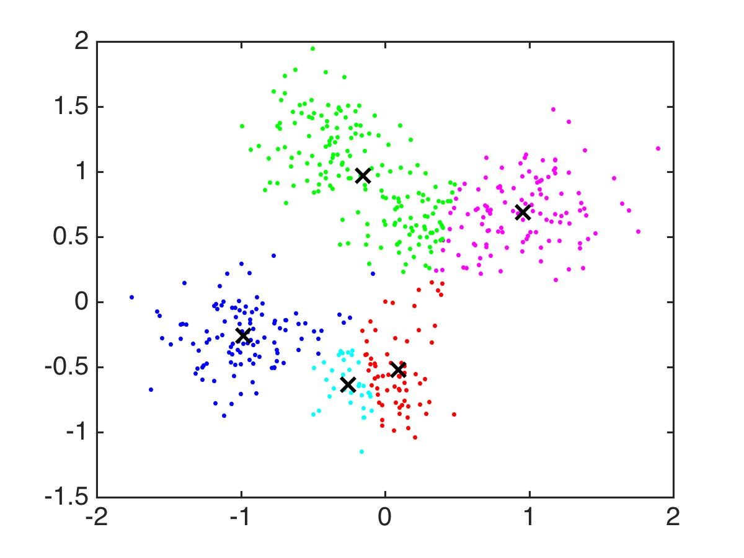

Slide 25
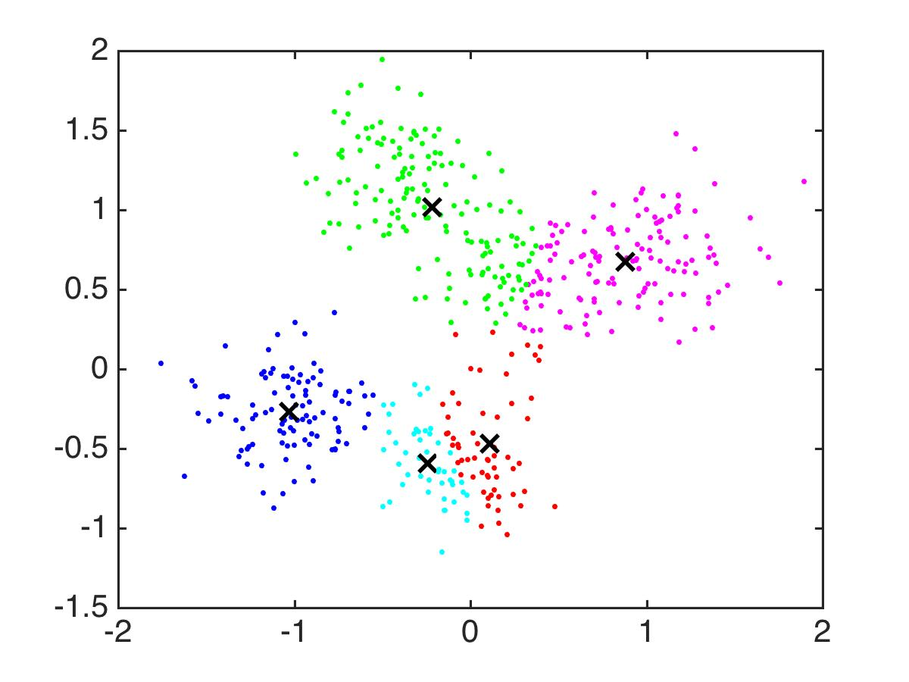

Slide 26
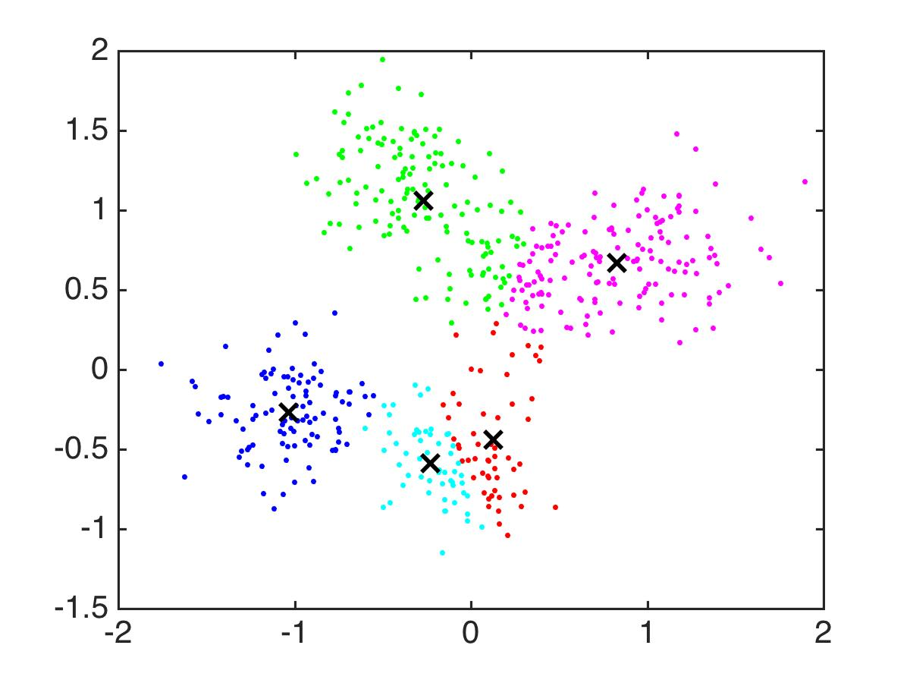

Slide 27
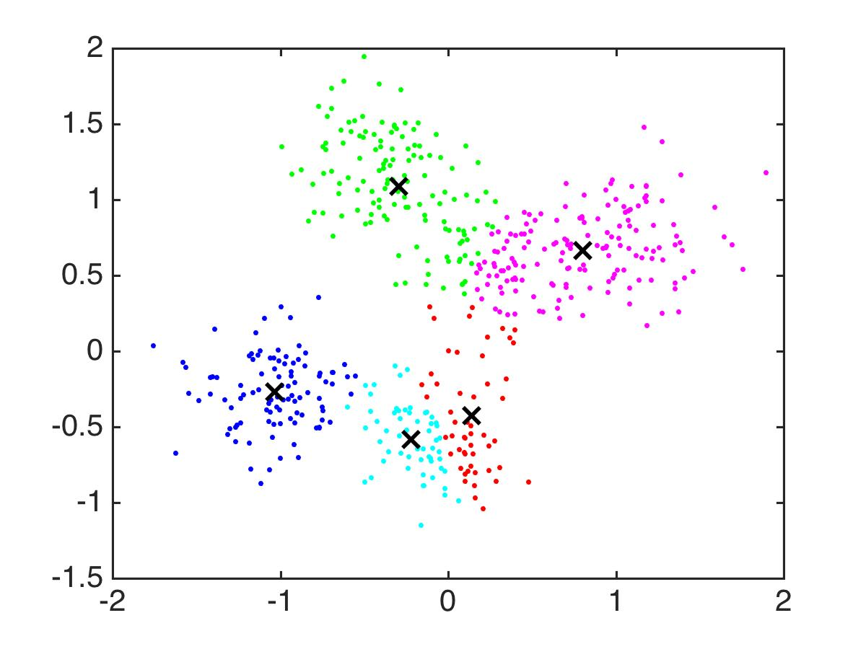

Slide 28
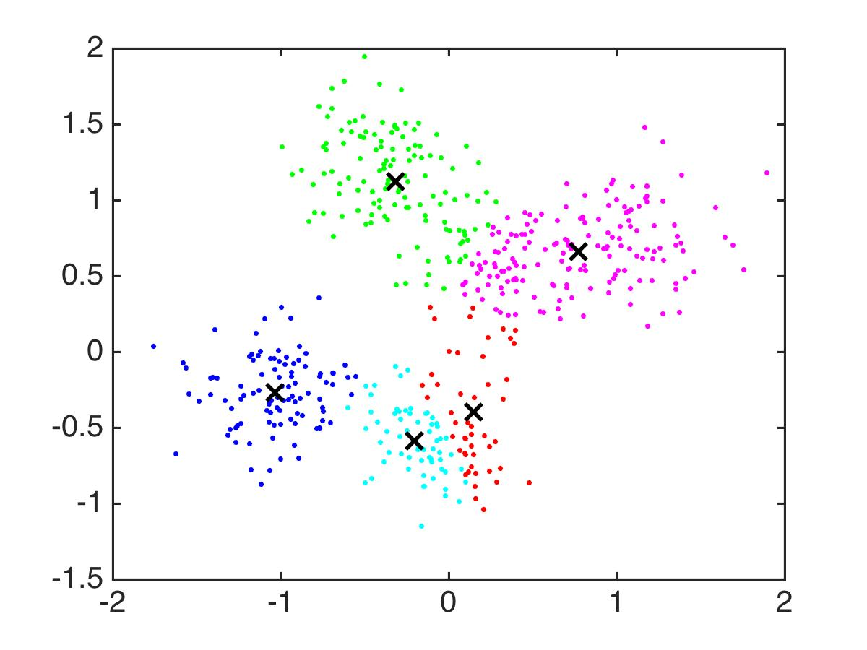

Slide 29
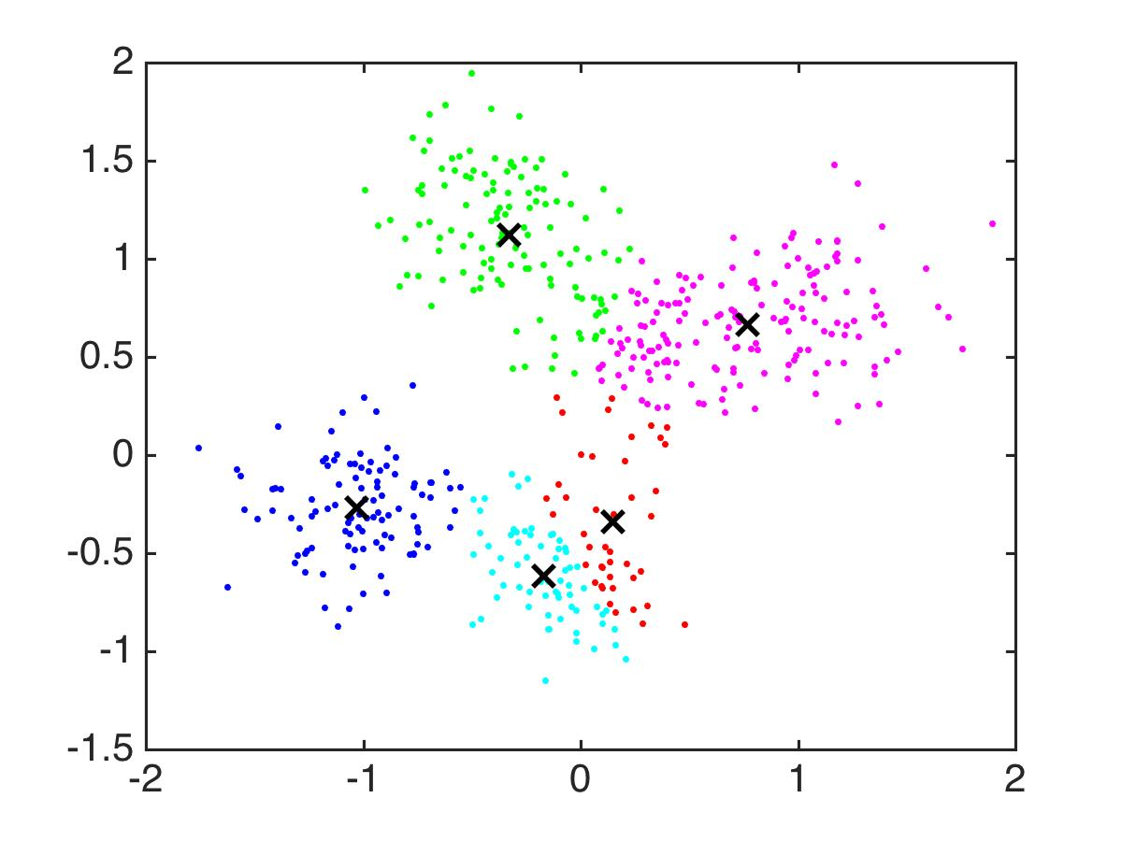

Slide 30
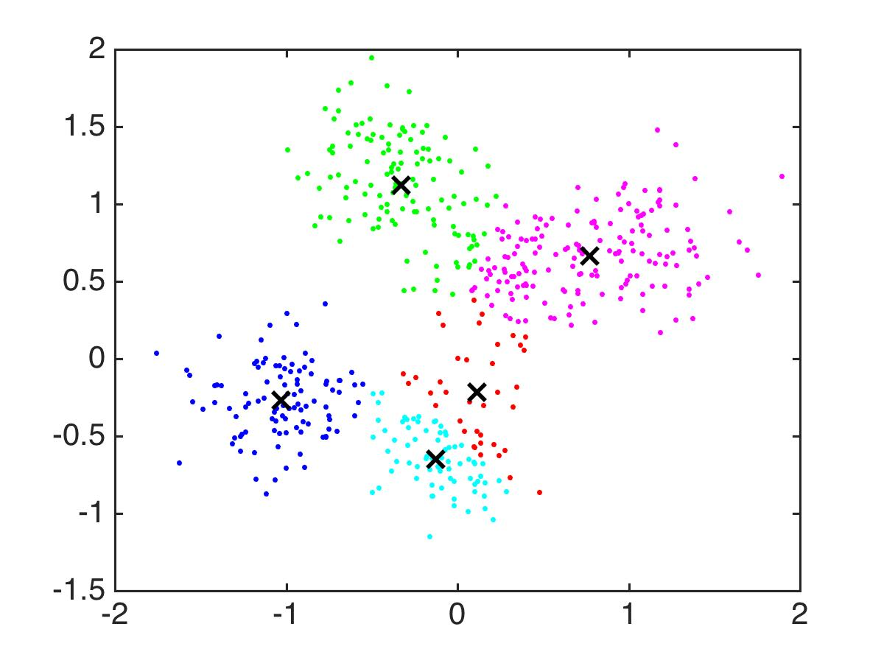

Slide 31
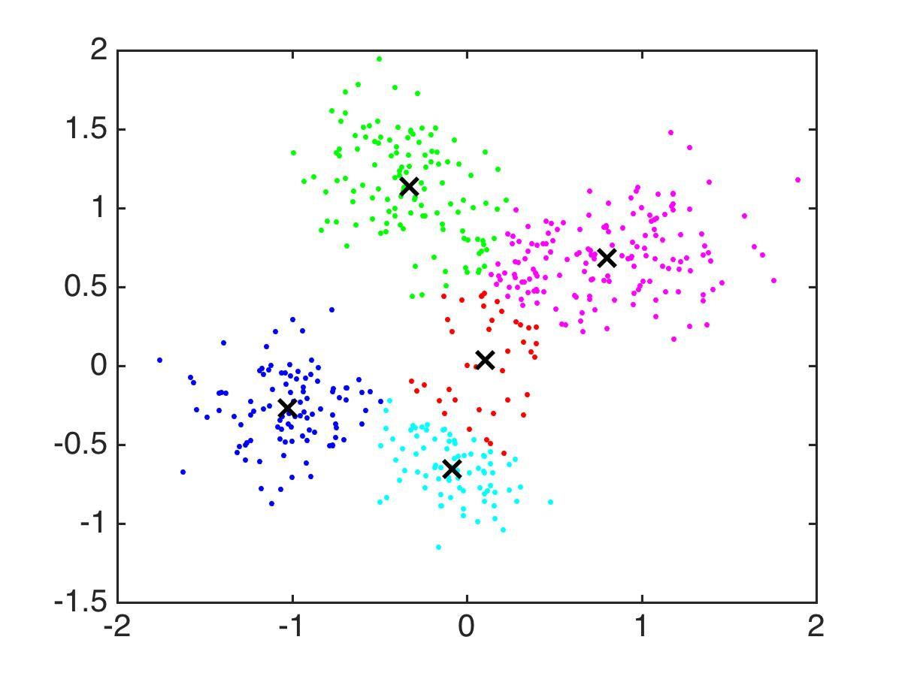

Slide 32
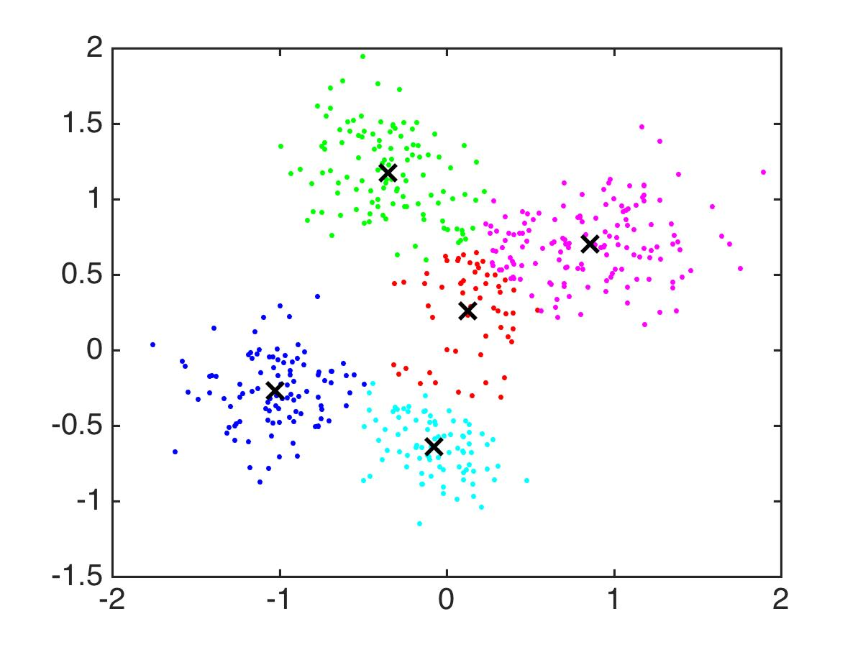

Slide 33
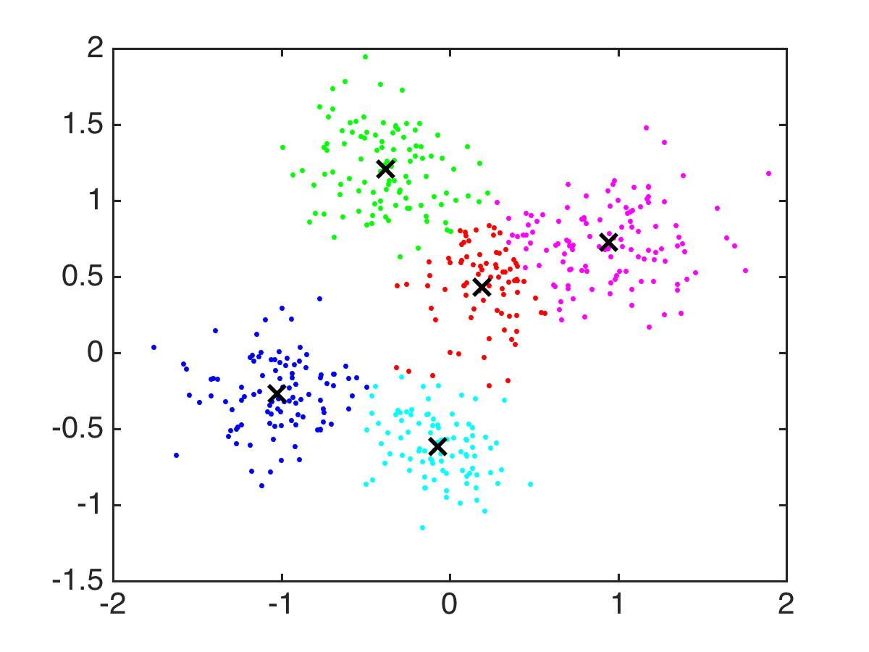

Slide 34


Slide 35


Slide 36


Slide 37


Slide 38


Slide 39

Notes:
STOP

Slide 40
K-Means Actual Goal
Input: Data set x₁,…,x_{n}, number of clusters K
Output: Cluster centers c₁,..,c_{K}
Goal: Minimize
Notes:
What is that thing? That’s the distance between a point x and cluster center ck. *min* You’re supposed to use the nearest cluster center. And you want to minimize the total distances to the nearest cluster centers.
Again, you’re trying to find the cluster centers that minimize the total distance from all the points to their nearest cluster center.
So that thing there, it’s a global objective. K means has local moves, it’s trying to optimize this but not the whole thing all at once like SVMs or logistic regression or anything.

Slide 41
K-Means Actual Goal
Input: Data set x₁,…,x_{n}, number of clusters K
Output: Cluster centers c₁,..,c_{K}
Goal: Minimize
Global minimization: Try all possible assignments of m points to K clusters:
Notes:
It would be really nice if we could just plain globally optimize this. Why the heck not?

Slide 42
K-Means Actual Goal
Notes:
I want to take a look at this cost again.

Slide 43
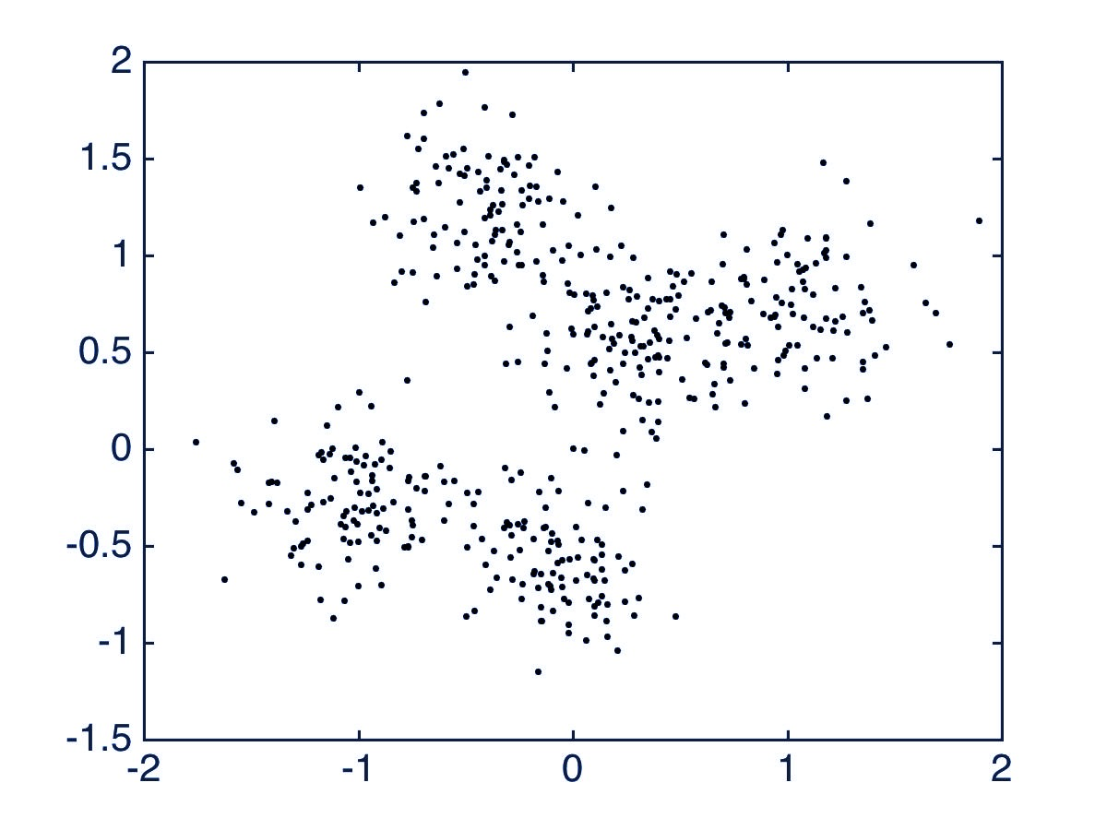
K-Means Actual Goal
X
X
Notes:
I want to take a look at this cost again.

Slide 44
K-Means Actual Goal
X
X
Notes:
I want to try a different order of summing things up.
The sum didn’t change, I just wrote it differently so I could sum things up in a different order.

Slide 45
K-Means Actual Goal
Notes:
Let’s try a slightly more general cost, because I want to allow us to optimize who is assigned to what cluster. So I’ll put the cluster assignments here. So cluster1 is all the points that are assigned to cluster 1, and so on. Now because I did this, the ck’s are no longer forced to be the centers of the clusters. We’ll make them that way, but I want to call them reference points now, because this function is so general that it can allow any points to be assigned to any cluster whose reference point can be literally anywhere, it doesn’t have to be in the center.

Slide 46
K-Means Actual Goal
Notes:
So this cost is a function of both the cluster assignments, so who is assigned to what cluster, and what we’re going to use as the reference points for the clusters. We want to be able to change those things around independently of each other and be able to evaluate the cost.

Slide 47

K-Means Actual Goal
X
(Assign points to the nearest cluster center)
X
Notes:
Let’s just look at the cost as if it’s a function of the cluster assignment only. If we fixed the ck’s, what is the best way to assign these clusters? *click* Assuming you’ve fixed the centers. *pause* The answer is obvious.

Slide 48
K-Means Actual Goal
X
(Assign centers to the middle of the points assigned to that cluster)
X
Notes:
Ok so on the other hand, what about assigning reference points? If we have the cluster assignments set, where would we put the reference points? Of course we’d put them in the center, to minimize the average distance to the reference points.

Slide 49
K-Means Actual Goal
Input: number of clusters K, randomly initialize centers c_{k}
Until converged:
Assign all points to the closest cluster center
Change cluster centers to be in the middle of its points
Notes:
So now you have a much better understanding of what kmeans is actually doing. I’ll put the cost up there just for reference. Remember it depends on both the cluster assignments and the centers. Now let’s put up the algorithm again *click*. Until you’re converged, you assign all points to the closest cluster center. And that’s the same thing as minimizing the cost by choosing the best assignments, given the cluster centers. And then for the next step, you change the reference points so that they really are cluster centers. *pause* And this minimizes the cost of those reference points, fixing the cluster assignments. So K means is a sort of alternating minimization scheme.

Slide 50
K-Means Actual Goal
Does K-Means achieve its goal?
Notes:
Now here’s a question for you. Given that Kmean’s actual goal is to minimize this cost, does it actually achieve this goal *click*. We know that the cost get lower at each step of K-means, but does it always converge to the globally optimal set of cluster assignments and reference points?

Slide 51
K-Means Actual Goal
Does K-Means achieve its goal?
Not always. Might need multiple replicates.
Notes:
Now here’s a question for you. Given that Kmean’s actual goal is to minimize this cost, does it actually achieve this goal *click*. We know that the cost get lower at each step of K-means, but does it always converge to the globally optimal set of cluster assignments and reference points?

Slide 52
K-Means Actual Goal
Does K-Means achieve its goal?
Not always. Might need multiple replicates. Even worse than that, its goal might not be the right one…
Notes:
Now here’s a question for you. Given that Kmean’s actual goal is to minimize this cost, does it actually achieve this goal *click*. We know that the cost get lower at each step of K-means, but does it always converge to the globally optimal set of cluster assignments and reference points?

Slide 53
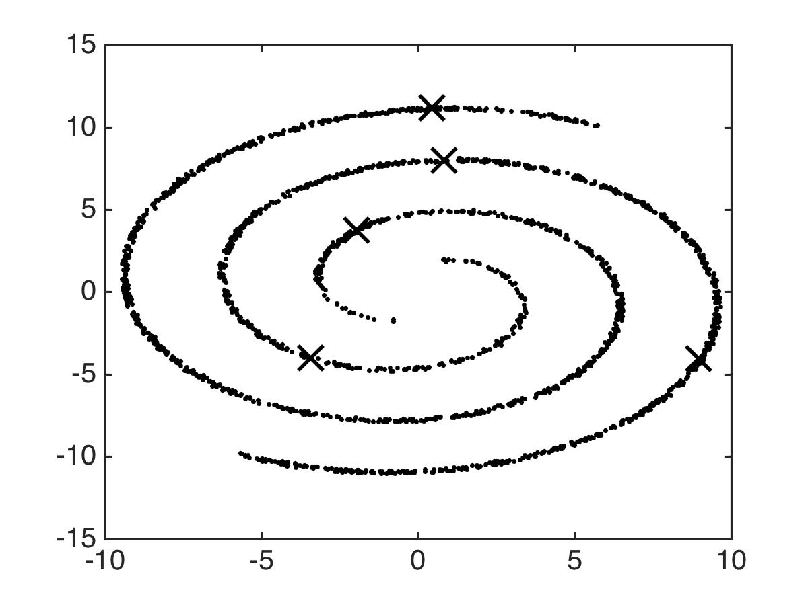
Notes:
The two guys on the top are going to separate a bit. Keep an eye on those ones.

Slide 54
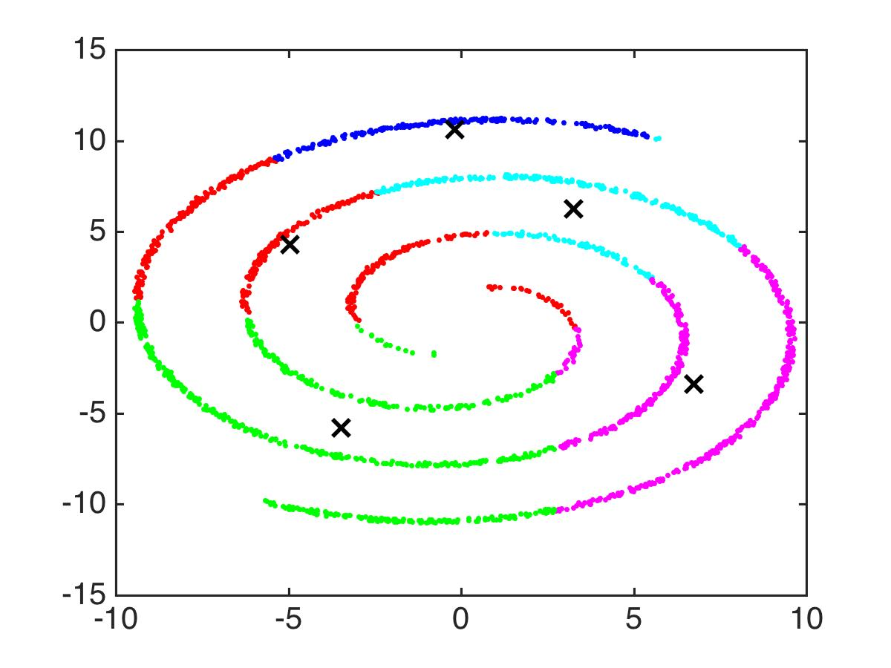

Slide 55
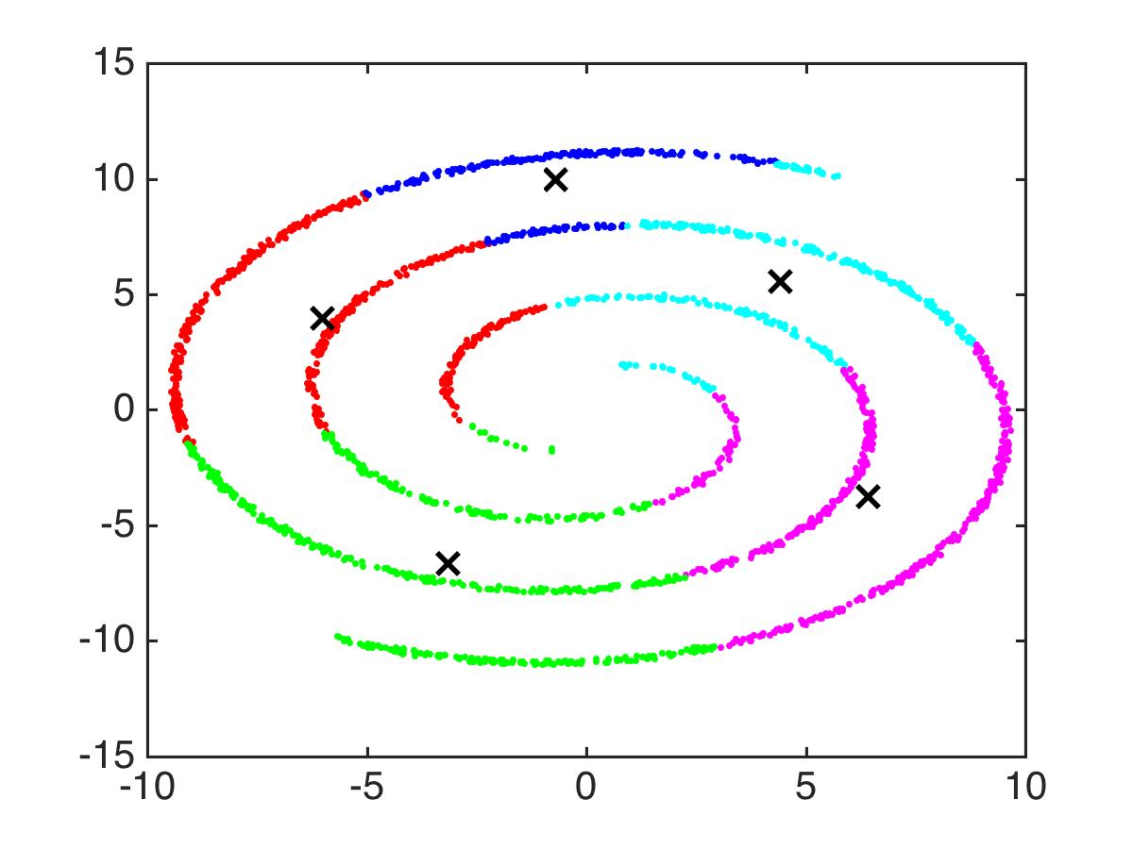

Slide 56
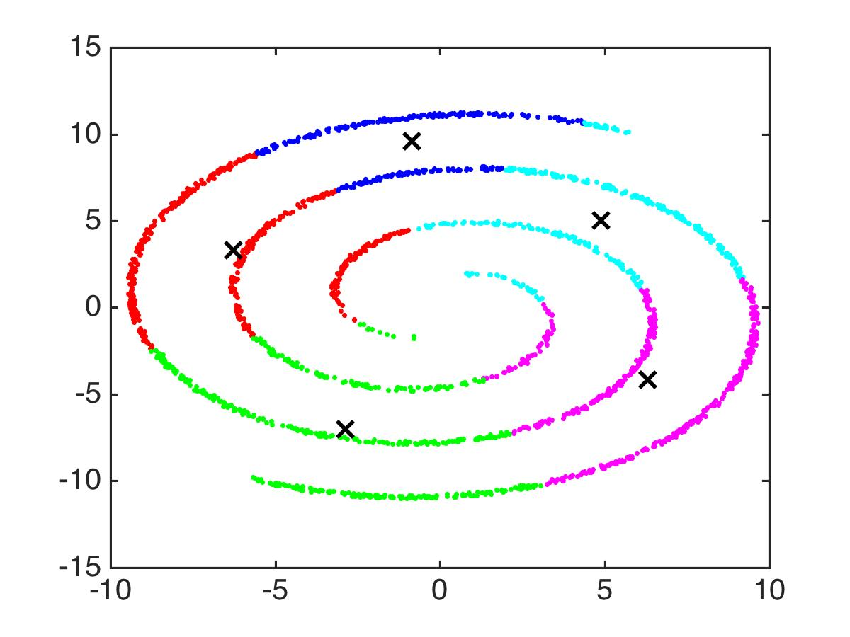

Slide 57
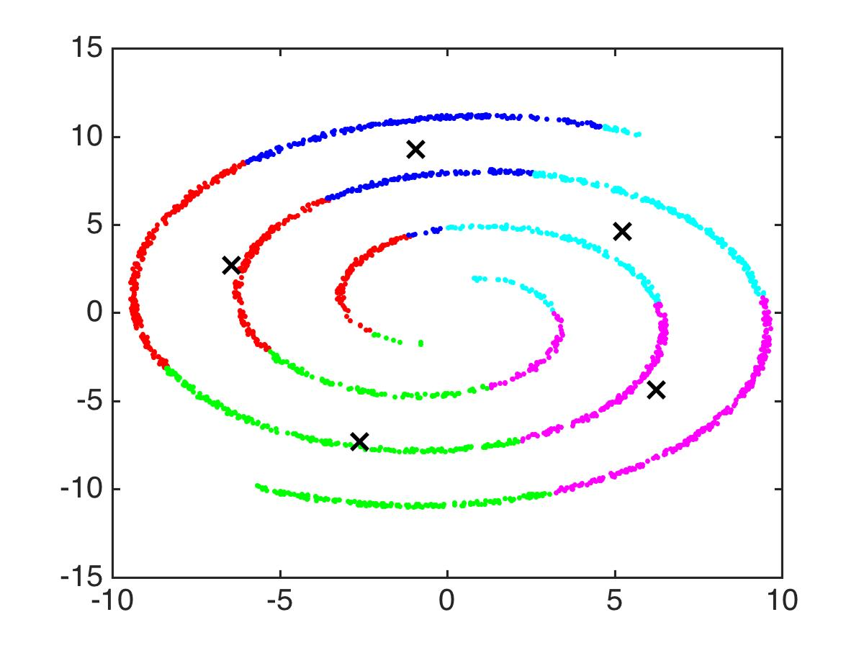

Slide 58
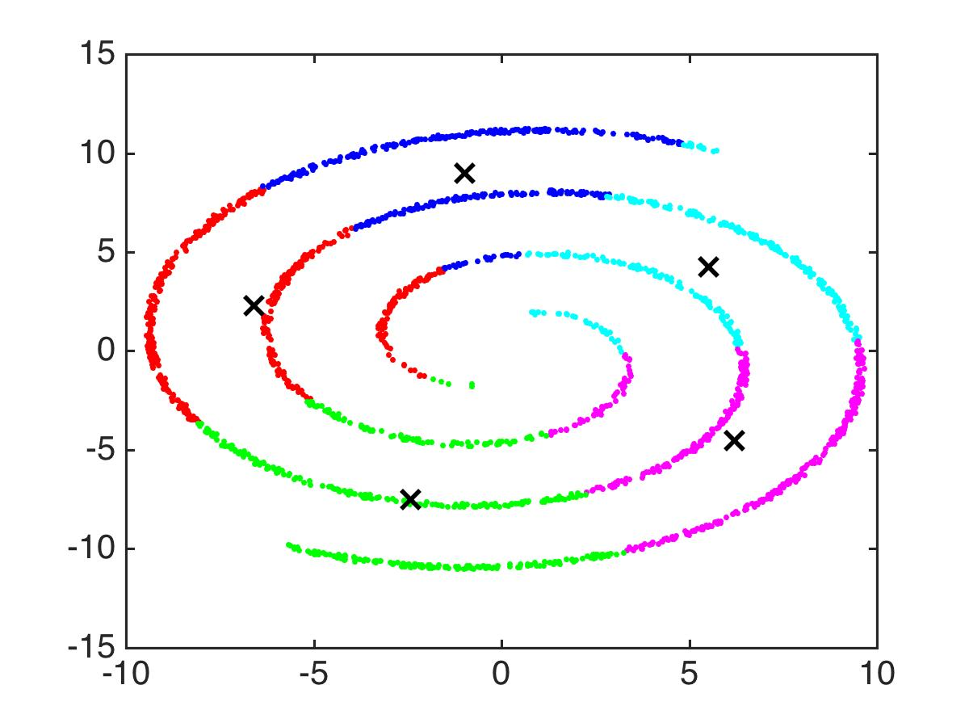

Slide 59
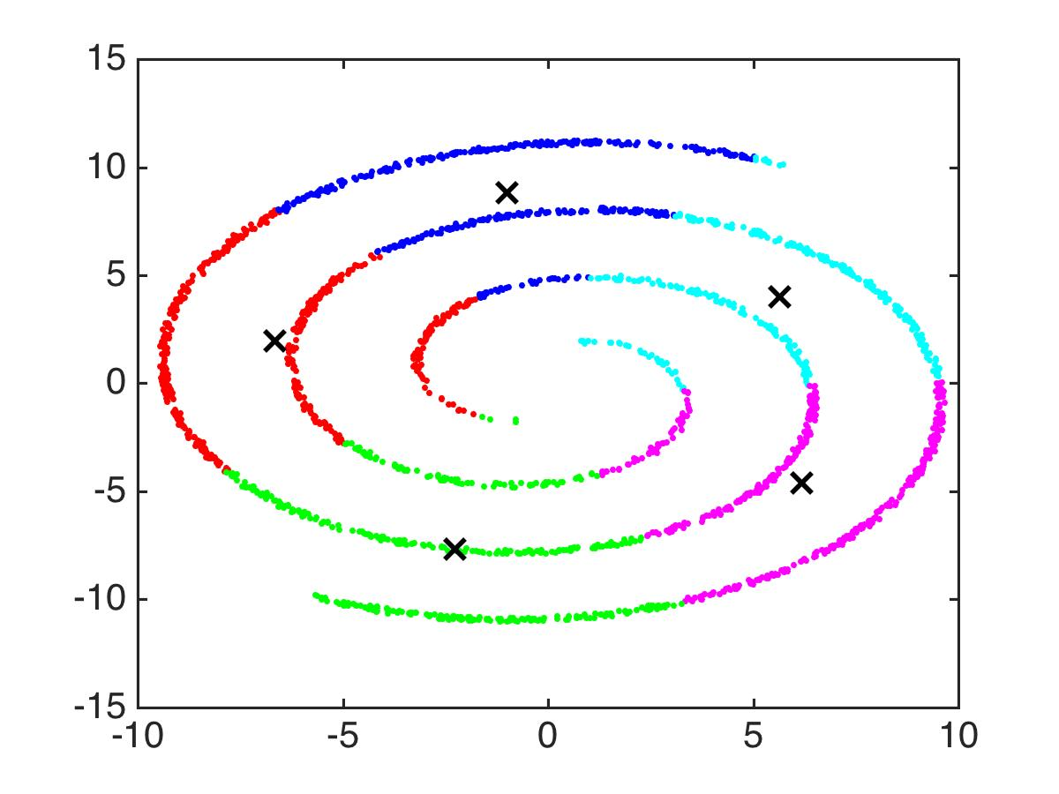

Slide 60


Slide 61


Slide 62


Slide 63


Slide 64


Slide 65


Slide 66
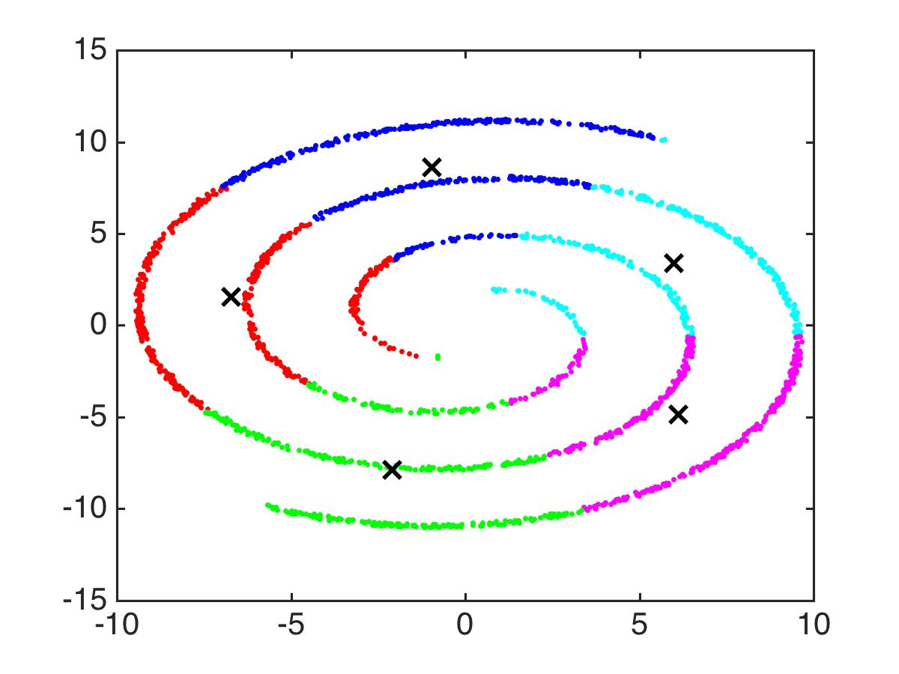

Slide 67


Slide 68


Slide 69


Slide 70
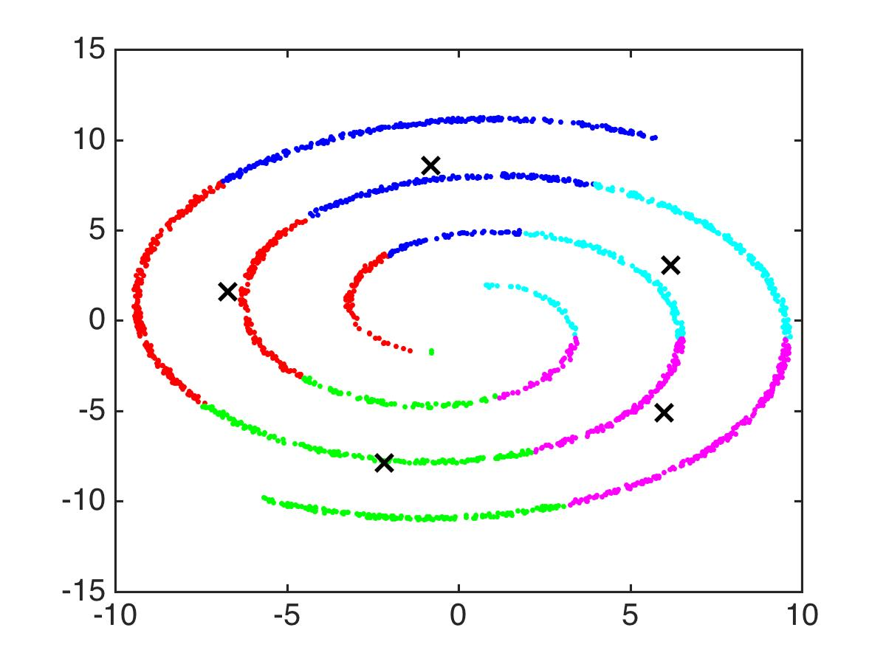

Slide 71


Slide 72


Slide 73


Slide 74


Slide 75


Slide 76


Slide 78
Notes:
STOP - And then it calls itself converged. Blech. Anyway. You can find worse examples where kmeans just doesn’t optimize its objective function. Here it did a good job optimizing the objective, it’s just that the objective was lousy for this dataset. Anyway, if you happen to start the reference points off in a bad spot sometimes, it just won’t go to the right place. That’s why most kmeans code allows you to do replicates so you can start with different randomly chosen points to be the centers. Anyway, it’s a nifty little algorithm. Very heavily used. And now you know what’s it’s doing.

Slide 79
Notes:
Let’s discuss a bit more about practical aspects of K means.

Slide 80
How to Choose K for K-Means
cost
kink
K
Use this number of clusters
Option 1: Look for the point of diminishing returns.
Notes:
There’s no single right answer.

Slide 81
How to Choose K for K-Means
cost
kink
K
?????
Option 2:????
Notes:
There’s no single right answer.

Slide 82
K-Means
Popular clustering algorithm, computationally efficient
Performs alternating minimization on a cost function
Does not always fully minimize that cost function (multiple replicates might be needed for a good solution)
Can use the cost function to evaluate whether one replicate is better than another
Can use cost function to help choose the number of clusters
Doesn’t work well for highly non-spherical clusters
Note: I used Euclidean distance, but can use other distances.
Notes:
finding the mean of a bunch of points is easy, and then it’s a single loop to find out what the cluster assignments are.

Slide 83
Hierarchical Agglomerative Clustering
Cynthia Rudin | MIT Sloan School of Management

Slide 84
Hierarchical Agglomerative Clustering
Start with each point in its own cluster
Repeatedly merge the clusters of the closest two points

Slide 85
Hierarchical Agglomerative Clustering
Start with each point in its own cluster
Repeatedly merge the clusters of the closest two points
Notes:
jellyroll

Slide 86
Hierarchical Agglomerative Clustering
Start with each point in its own cluster
Repeatedly merge the clusters of the closest two points
Notes:
jellyroll

Slide 87
Hierarchical Agglomerative Clustering
Start with each point in its own cluster
Repeatedly merge the clusters of the closest two points
Notes:
jellyroll

Slide 88
Hierarchical Agglomerative Clustering
Start with each point in its own cluster
Repeatedly merge the clusters of the closest two points
Notes:
jellyroll

Slide 89
Hierarchical Agglomerative Clustering
Start with each point in its own cluster
Repeatedly merge the clusters of the closest two points
Notes:
jellyroll

Slide 90
Hierarchical Agglomerative Clustering
Start with each point in its own cluster
Repeatedly merge the clusters of the closest two points
Notes:
jellyroll

Slide 91
Hierarchical Agglomerative Clustering
Start with each point in its own cluster
Repeatedly merge the clusters of the closest two points
Notes:
jellyroll

Slide 92
Hierarchical Agglomerative Clustering
Start with each point in its own cluster
Repeatedly merge the clusters of the closest two points
Notes:
jellyroll

Slide 93
Hierarchical Agglomerative Clustering
Start with each point in its own cluster
Repeatedly merge the clusters of the closest two points
Notes:
jellyroll

Slide 94
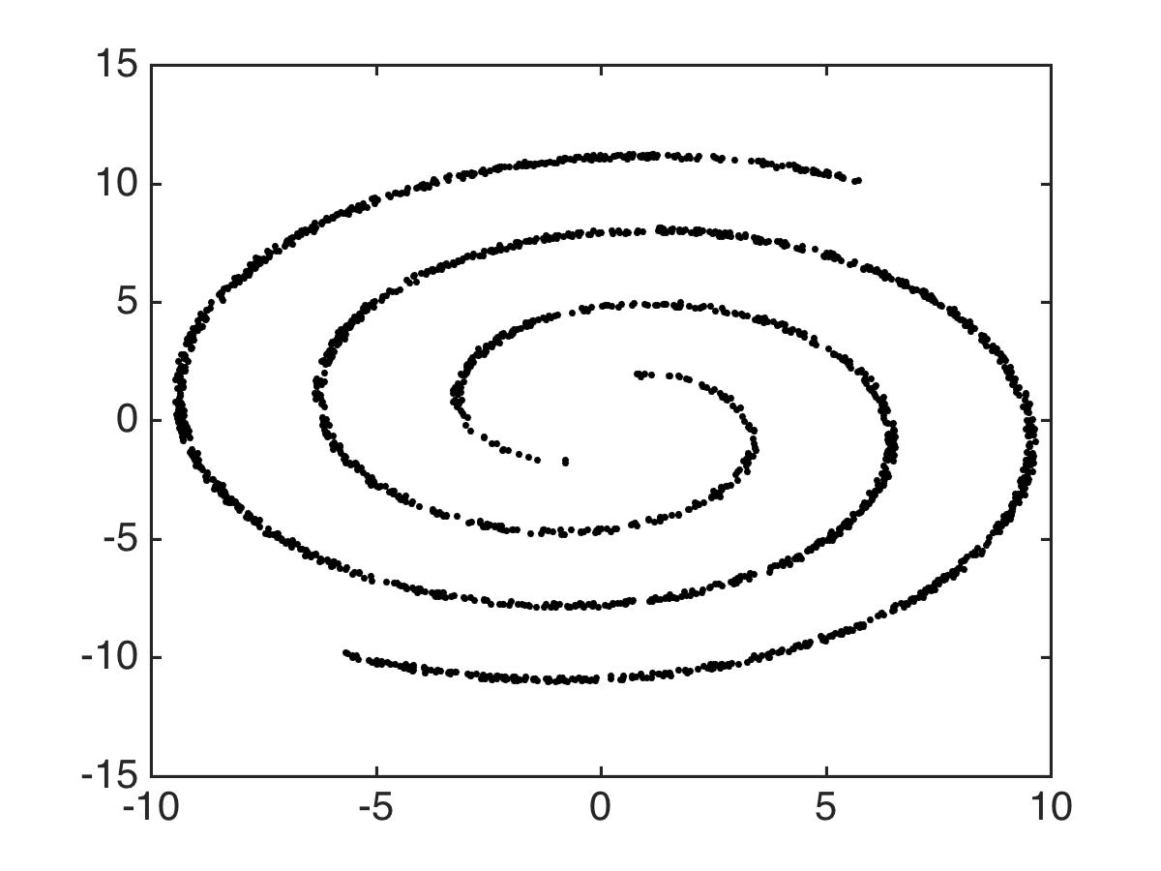

Slide 95
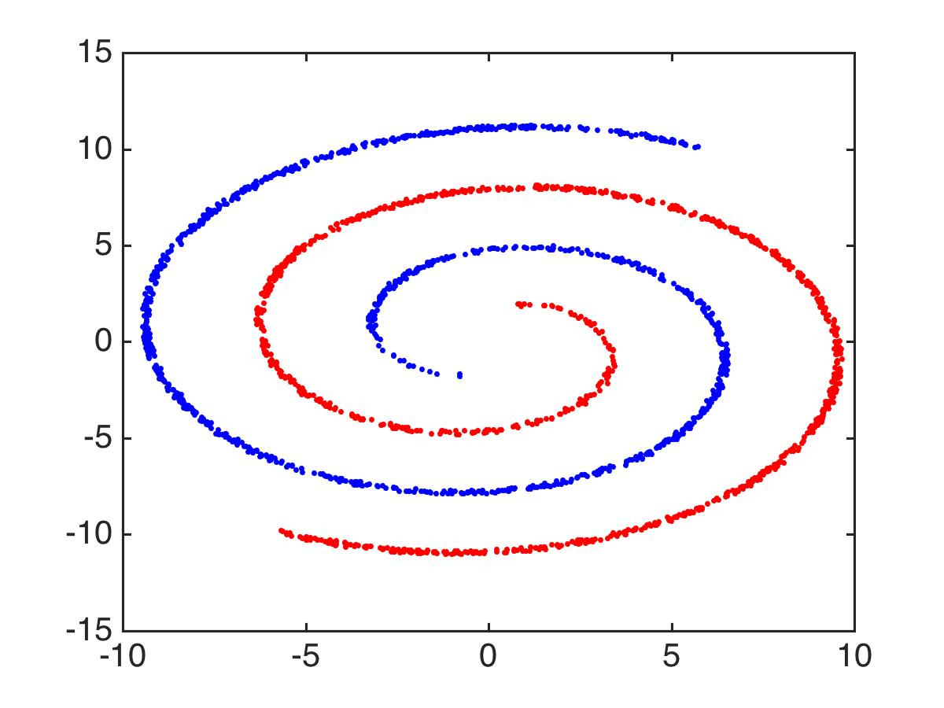

Slide 96
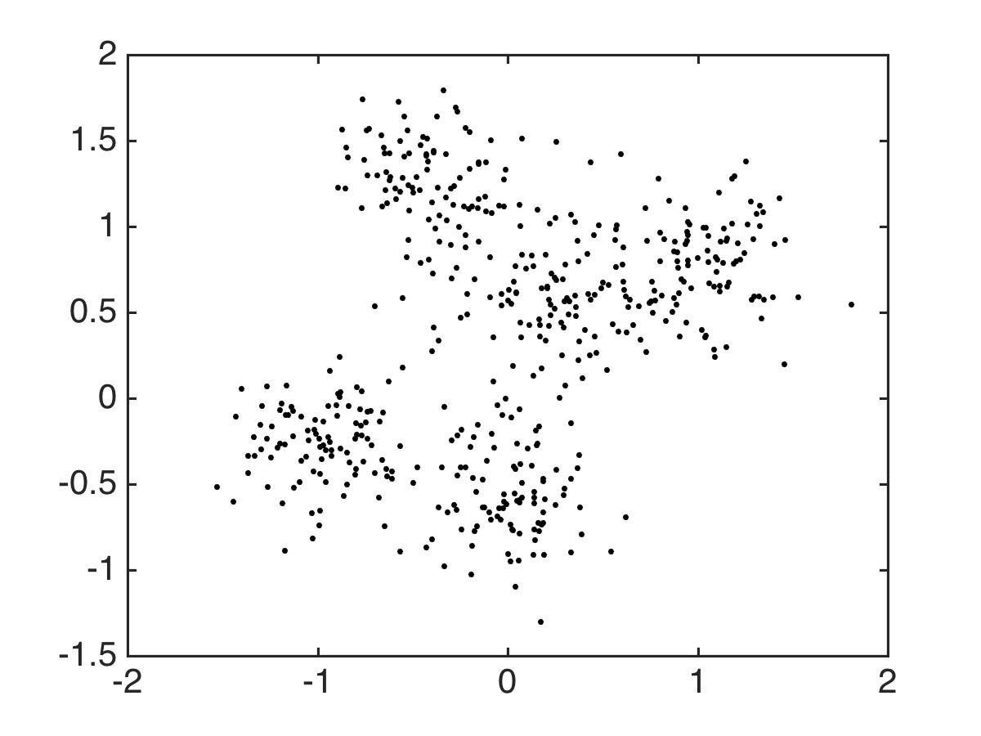

Slide 97
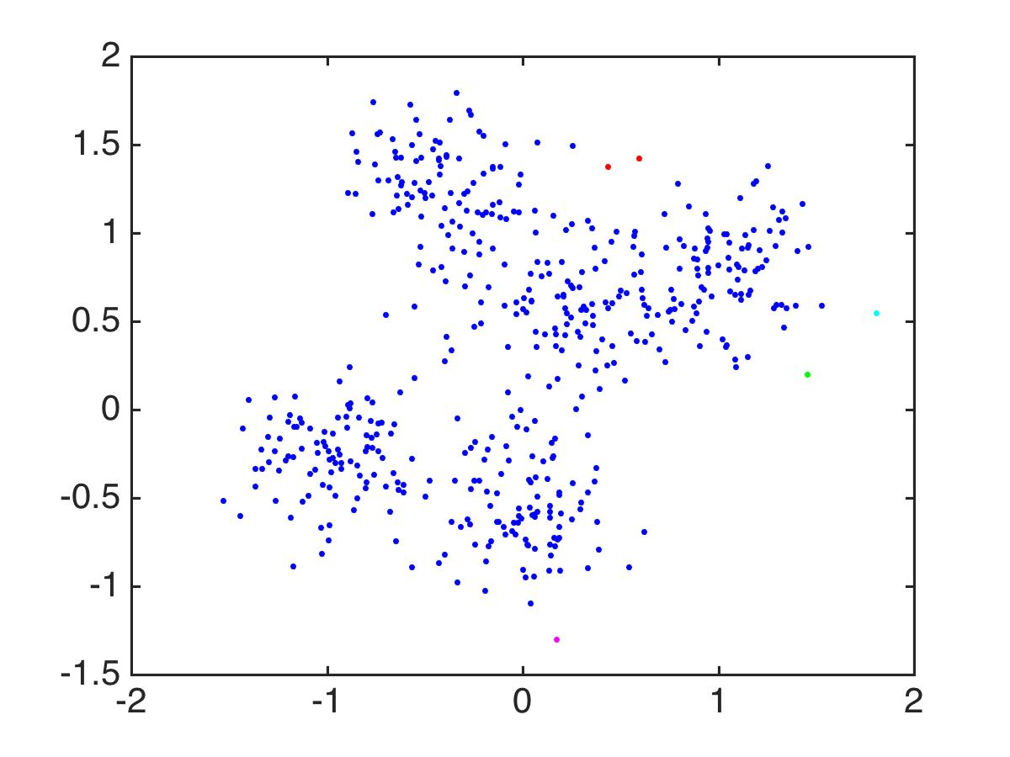

Slide 98
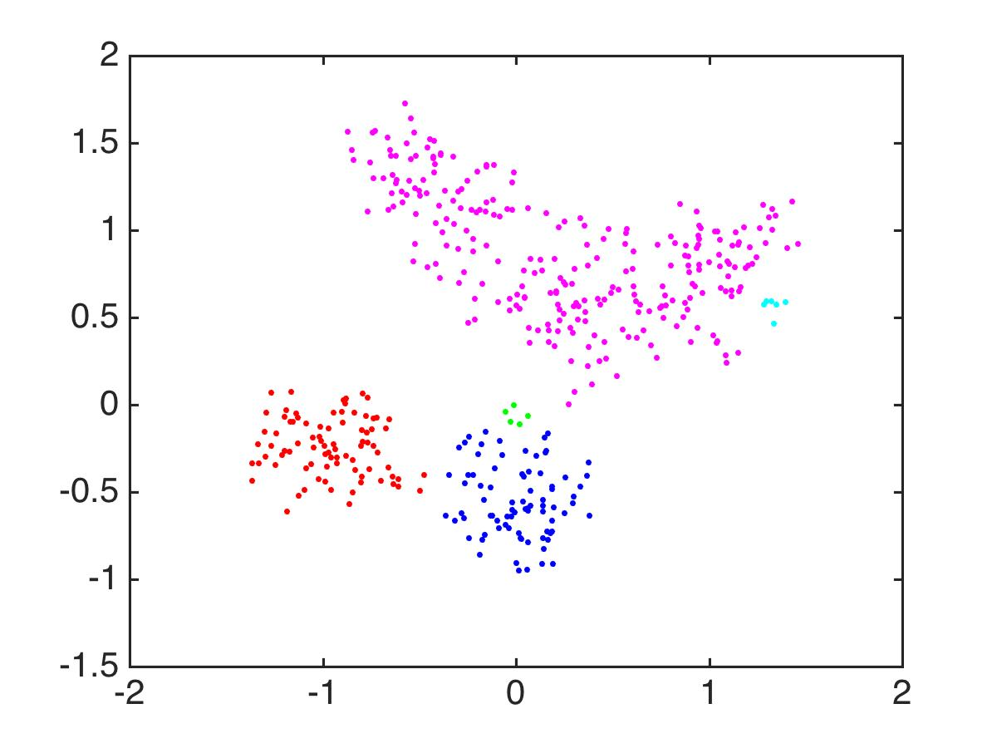
Notes:
So that’s sort of far from perfect. This algorithm is just not meant for these kind of overlapping spherical clusters. It does much better with these separated but twisty clusters. Long skinny clusters, no problem for HAC. Anyway.

Slide 99
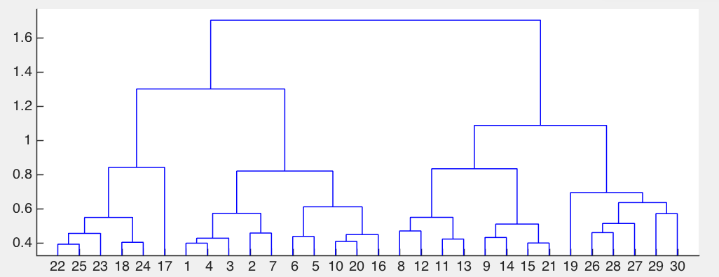
Dendrogram for Hierarchical Agglomerative Clustering
Notes:
HAC produces these dendrograms that tell you what clusters are being merged.

Slide 100
Dendrogram for Hierarchical Agglomerative Clustering
7
Notes:
HAC produces these dendrograms that tell you what clusters are being merged.

Slide 101
Dendrogram for Hierarchical Agglomerative Clustering
2
Notes:
HAC produces these dendrograms that tell you what clusters are being merged.

Slide 102
K-Means vs Hierarchical Agglomerative Clustering
Both are useful for different sorts of problems. K-Means works well for spherical data.
Hierarchical Agglomerative Clustering is useful when clusters are well-separated. (This means data that are close together should be in the same cluster.)
For K-means, one needs to choose the number of clusters (try a few different ones). For hierarchical clustering, one chooses when to stop merging clusters.
The distance metric is important. Can have a large impact on the solution.
Notes:
but the data can be on very complicated manifolds that kind of loop around each other and that’s totally fine.

Slide 103
06 | Recommender Systems
Cynthia Rudin | MIT Sloan School of Management

Slide 104
Recommender Systems and Matrix Factorization
User-based collaborative filtering
Item-based collaborative filtering
Matrix factorization
Notes:
This is a huge topic, and we can’t cover the whole thing. So we chose a couple of particularly important well-used topics.

Slide 105
User-Based Collaborative Filtering and Item-Based Collaborative Filtering

Slide 106
The Netflix contest: Build a better recommender system from Netflix data
Dark Knight
Alien
Bug’s Life
Cars
Carmen
Joseph
Leonore
Esmerelda
Use the crowd’s votes to complete the missing entries

Slide 107
Option 1: User-Based Collaborative Filtering: Fill in Carmen’s score for Alien using similar users’ ratings.
Dark Knight
Alien
Bug’s Life
Cars
Carmen
Joseph
Leonore
Esmerelda
Notes:
Who is similar to Carmen? Possibly Joseph. Definitely not Leonore. Need a measure to find similar users.

Slide 108
Option 2: Item-Based Collaborative Filtering: Fill in Joseph’s score for Dark Knight using similar items’ ratings.
Dark Knight
Alien
Bug’s Life
Cars
Carmen
Joseph
Leonore
Esmerelda
Notes:
Which items are similar to Dark Knight? Cars definitely. Maybe Aliens.
Both of these use a similar algorithmic idea, which is to find similar situations and use those to make a recommendation. Let’s go back to the user-based collaborative filtering and talk about how to do that for a bit.

Slide 109
Option 1: User-Based Collaborative Filtering: Fill in Carmen’s score for Alien using similar users’ ratings.
Dark Knight
Alien
Bug’s Life
Cars
Carmen
Joseph
Leonore
Esmerelda
Notes:
need a measure to find similar users.

Slide 110
User-Based Collaborative Filtering & Correlation
Correlation between Carmen and User U
Notes:
For the similarity measure between users, we’re going to use correlation. This is just plain correlation between Carmen and User U. If Carmen’s highly rated movies are the same as User U’s highly rated movies, that’ll lead to a higher correlation. If Carmen’s low rated movies are the same as User U’s low rated movies, that will lead to a high correlation too. If they disagree on which movies to rate highly, the correlation will be lower. *pause*. Now, since we’re trying to figure out which movies Carmen is going to like, we’ll choose to listen more to users who have a higher correlation with Carmen. And so now that we have a way to determine what users we want to pay attention to, we’re going to find out what they thought of movie m, and average their votes… weighted by similarity to Carmen.

Slide 111
User-Based Collaborative Filtering & Correlation
where sim is:
Notes:
Here’s that. But I’m going to break it down a bit. I’ll put the whole thing back up in a minute.
The sum over movies is just movies that both people have rated. One problem with this measure is it tends to favor users who have watched very few movies that overlap with Carmen but that agree with her on the movies they watched.

Slide 112
User-Based Collaborative Filtering & Correlation
Notes:
The thing I want to estimate is Carmen’s rating of Alien, which she has not seen.

Slide 113
User-Based Collaborative Filtering & Correlation
Notes:
We’ll start with Carmen’s average rating, and then if we think she’ll like it, the rating will be above her average. If we don’t think she’ll like it, then the rating will be below her average.

Slide 114
User-Based Collaborative Filtering & Correlation
How much did U like Alien?
Notes:
We will look at all of the other users, and see whether they rated Alien above or below their average rating. So here, we’re considering how much user U liked Alien. And now remember, we want to weight each user by their similarity to Carmen. So we’re doing to take a weighted average of the user’s votes.

Slide 115
User-Based Collaborative Filtering & Correlation
Weight users by similarity to Carmen
Notes:
And then we will weight the users by how similar they are to Carmen. The users who are more similar than others will get larger weights. Because we have the denominator there, all the weights will add up to one. And that’s the final estimate for Carmen’s estimated rating for Alien.

Slide 116
User-Based Collaborative Filtering & Correlation
where sim is:
Notes:
Here’s that. But I’m going to break it down a bit. I’ll put the whole thing back up in a minute.
The sum over movies is just movies that both people have rated. One problem with this measure is it tends to favor users who have watched very few movies that overlap with Carmen but that agree with her on the movies they watched.

Slide 117
User-Based Collaborative Filtering & Correlation
Benefits of this approach: Easy
Disadvantages: If there are lots of users & movies, and not many users have rated each movie, similarities won’t be accurate, estimates will be poor.
Doesn’t take into account how similar the items are.

Slide 118
Option 2: Item-Based Collaborative Filtering: Fill in Joseph’s score for Dark Knight using similar items’ ratings.
Dark Knight
Alien
Bug’s Life
Cars
Carmen
Joseph
Leonore
Esmerelda
Notes:
Both of these use a similar algorithmic idea, which is to find similar situations and use those to make a recommendation. Let’s go back to the user-based collaborative filtering and talk about how to do that for a bit.

Slide 119
Option 2: Item-Based Collaborative Filtering: Fill in Joseph’s score for Dark Knight using similar items’ ratings.
Dark Knight
Alien
Bug’s Life
Cars
Carmen
Joseph
Leonore
Esmerelda
Notes:
And so again, you would use correlations to weight the previous recommendations by how similar an item is to past ones. This can be pretty similar to the user-based collaborative filtering, so I won’t repeat the formula.

Slide 120
Item-Based Collaborative Filtering & Correlation
Benefits of this approach: Easy, supposedly in practice item-item similarities are more robust than user-user similarities
Disadvantages: Again could have poor estimates for unpopular items.
Doesn’t take into account how similar the users are to the current one.

Slide 121
Matrix Factorization
Notes:
Matrix factorization takes into account both similarity to users and similarity to items. This is, in some sense, the Mililon dollar idea that helped win the netfiix competition.

Slide 122
Matrix Factorization
Aliens
Dark Knight
Bug’s Life
Cars
Carmen
Notes:
Let’s start with Carmen’s ratings.

Slide 123
Matrix Factorization
Aliens
Dark Knight
Bug’s Life
Cars
Carmen
Scary
Kiddy
Carmen¹
Notes:
Carmen1 is the essence of Carmen. It’s actually who she really is. She likes scary movies and dislikes kiddy movies. So the fact that Aliens stars whatever actors it stars doesn’t really matter, she likes it because it’s scary. If you knew Carmen’s essence, you’d be able to figure out her ratings for Bug’s Life, which is a kiddy movie. Doesn’t matter how good of a kiddy movie Bug’s Life is, she just doesn’t like kiddy movies, so she’s going to give it a low rating most likely.

Slide 124
Matrix Factorization
Scary
Kiddy
Scary
Kiddy
Carmen¹
Dark Knight
Notes:
So, let’s take a movie like Dark Knight, which is about batman, but it’s for grownups, so it’s sort of half scary and half kiddy.

Slide 125
Matrix Factorization
Scary
Kiddy
Scary
Kiddy
Carmen¹
Dark Knight
My guess for Carmen’s rating on Dark Knight:
Notes:
So here’s my guess for Carmen’s rating, it’s sort of half way between what she’d say for a scary movie and for a kiddy movie.

Slide 126
Matrix Factorization
Aliens
Dark Knight
Bug’s Life
Cars
Carmen
Scary
Kiddy
Scary
Kiddy
Carmen¹
Dark Knight
My guess for Carmen’s rating on Dark Knight:
Notes:
Let’s put her actual ratings up that we had before and you can see that our guess agreed with how she actually rated it, which means that our values for Carmen1 might be pretty accurate. The nice thing is that if you have carmen1, then you can sort of figure out how Carmen is going to rate a lot of different movies, as long as you know whether they are scary or kiddy movies.

Slide 127
Matrix Factorization
Dark Knight
Aliens
Cars
Bug’s Life
Carmen
Scary
Kiddy
Scary
Kiddy
Carmen¹
Dark Knight
My guess for Carmen’s rating on Dark Knight:
Notes:
So you could guess her ratings for lots of different movies.
Doesn’t matter how many movies we’re considering, as long as we know the secret information, the essence of Carmen, then we can pretty much figure out what most of her ratings are going to look like

Slide 128
Matrix Factorization
Figures out the latent space
How to represent each user in the space
How to represent each movie in the space
Notes:
Matrix factorization figures out the latent factors. If the latent factors are really good, then we’re golden. That way, there can be very few latent factors and we can still recover ratings that are a pretty good approximations of the real ratings even though there might be thousands of movies. *talk about netlfix, when people realized matrix factorization techniques worked really well here”.
If you have a new movie that the user hasn’t seen before, as long as you know the latent state of the movie and the latent state of the user, you can guess.

Slide 129
Matrix Factorization
Scary
Kiddy
Scary
Kiddy
Carmen
Dark Knight
Notes:
Let’s go back to this example. Remember we’re going to represent carmen in terms of her latent interest in scary and kiddy movies. And we’ll represent dark knight in terms of its membership in the latent factors scary and kiddy.

Slide 130
Matrix Factorization
Scary
Kiddy
Scary
Kiddy
Carmen
Dark Knight
My guess for Carmen’s rating on Dark Knight:
Notes:
And remember the way we computed the rating estimate for Carmen on dark knight. This is just the inner product of these two vectors if you’re familiar with that terminology. We’re just multiplying the first terms of each vector and the second terms and so forth and adding them up at the end. I’m Just going to rewrite it in typical matrix notation.

Slide 131
Matrix Factorization
Dark Knight
Scary
Kiddy
Scary
Carmen
Kiddy
My guess for Carmen’s rating on Dark Knight:
Notes:
And remember the way we computed the rating estimate for Carmen on dark knight. This is just the inner product of these two vectors if you’re familiar with that terminology. We’re just multiplying the first terms of each vector and the second terms and so forth and adding them up at the end. I’m Just going to rewrite it in typical matrix notation.

Slide 132
Matrix Factorization
Dark Knight
Dark Knight
Scary
Kiddy
Carmen
Scary
Carmen
Kiddy
My guess for Carmen’s rating on Dark Knight:
Notes:
Let’s put Carmen’s rating for dark knight right there. And you can see I’ve left room over on the right to put in other people’s estimated ratings for lots of movies.

Slide 133
Matrix Factorization
Dark Knight
Dark Knight
Scary
Kiddy
Carmen
Scary
Carmen
Kiddy
My guess for Carmen’s rating on Dark Knight:
Notes:
I’ll even put parentheses there, and that’ll show you that the rating for carmen1 on dark knight is
For instance, if we added another user in there, and we wanted her estimated rating for dark knight, where would that go?

Slide 134
Matrix Factorization
Dark Knight
Dark Knight
Scary
Kiddy
Carmen
Scary
Carmen
Leonore
Kiddy
Leonore
My guess for Leonore’s rating on Dark Knight:

Slide 135
Matrix Factorization
Jurassic Park
Dark Knight
Dark Knight
Jurassic Park
Scary
Kiddy
Carmen
Scary
Carmen
Leonore
Kiddy
Leonore

Slide 136
Matrix Factorization
Jurassic Park
Dark Knight
Dark Knight
Jurassic Park
Scary
Kiddy
Carmen
Scary
Carmen
Leonore
Kiddy
Leonore

Slide 137
Matrix Factorization
Jurassic Park
Yuck Factor
Dark Knight
Dark Knight
Jurassic Park
Zootopia
Kiddy
Scary
Carmen
Carmen
Leonore
Scary
Leonore
Kiddy
Joseph
Joseph
Yuck Factor

Slide 138
Matrix Factorization
Jurassic Park
Yuck Factor
Dark Knight
Dark Knight
Jurassic Park
Zootopia
Kiddy
Scary
Carmen
Carmen
Leonore
Scary
Leonore
Kiddy
Joseph
Joseph
Yuck Factor

Slide 139
Matrix Factorization
Jurassic Park
Yuck Factor
Dark Knight
Dark Knight
Jurassic Park
Zootopia
Kiddy
Scary
Carmen
Carmen
Leonore
Scary
Leonore
Kiddy
Joseph
Joseph
Yuck Factor

Slide 140
Customer ➔ Latent
Latent ➔ Movies
Jurassic Park
Yuck Factor
Dark Knight
Dark Knight
Jurassic Park
Zootopia
Kiddy
Scary
Carmen
Carmen
Leonore
Scary
Leonore
Kiddy
Joseph
Joseph
Yuck Factor

Slide 141
Customer ➔ Latent
Latent ➔ Movies
Customer ➔ Movies
Jurassic Park
Dark Knight
Carmen
Leonore
P
Q^{T}
Joseph

Slide 142
The model:
How to choose P and Q^{T}?
Notes:
http://www.quuxlabs.com/blog/2010/09/matrix-factorization-a-simple-tutorial-and-implementation-in-python/

Slide 143
The model:
How to choose P and Q^{T}?
to minimize
Notes:
http://www.quuxlabs.com/blog/2010/09/matrix-factorization-a-simple-tutorial-and-implementation-in-python/

Slide 144
The model:
How to choose P and Q^{T}?
to minimize
Notes:
http://www.quuxlabs.com/blog/2010/09/matrix-factorization-a-simple-tutorial-and-implementation-in-python/

Slide 145
Calculate gradients for gradient descent on the errors:
Notes:
http://www.quuxlabs.com/blog/2010/09/matrix-factorization-a-simple-tutorial-and-implementation-in-python/
alternating gradient steps to minimize p and q. Alpha is a learning rate. If you set the learning rate to large, you’ll overshoot the minimum and it’ll oscillate. if you set it too big it’ll take forever to converge. Again hopefully you shouldn’t have to deal with this, in a good implementation either you’ll just fiddle around with this one number. You can also add regularization to this, and it would just give you an extra factor in each of the two gradients, so a trivial extension. Now I should warn you that this method doesn’t necessarily converge to the global minimizer of the matrix factorization problem. The objective is not convex, which means that local minimizers are not necessarily local minimizers, but this particular method does seem to work pretty well in practice, which is what the competitors in the Netflix competition noticed.

Slide 146
Carmen
Carmen
Leonore
Leonore
Joseph
Joseph
Question: Is what we’re doing the same as setting the ?’s to 0 and doing least square regression?
Answer: No, that won’t work. We only consider errors that we can calculate.

Slide 147
Matrix Factorization
Key strategy in winning Netflix Prize competition.
Notes:
Although the winning entry was quite a bit more complicated than matrix factorization. I got a chance to hear a talk by one of the winners of that competition and it was really cool. I wasn’t sure what to expect when I heard that talk, I thought it was going to be a lot of complicated technical trickery, but it wasn’t, it was really beautiful. These guys really looks hard at the data. This was the main thing that set them apart from the rest of the teams, these guys *knew* how people *behave* when they rate movies. They realized all sorts of interesting stuff, like that when people rate multiple products at once, their ratings change from when they are rating a single product at a time. So their model was absolutely laden with gems of sort of behavioral psychology of movie raters. It started with matrix factorization – just like what I’m describing – as the foundation, and then it took into account a lot of interesting ways in which people behave when they are rating products to adjust the predictions.

